Slide 1
The Accounting Faculty Dilemma
CFBSD: Accounting Working Group
November 18, 2013
Tim Daus, Sandy Hilton, Tom Scott

Slide 3
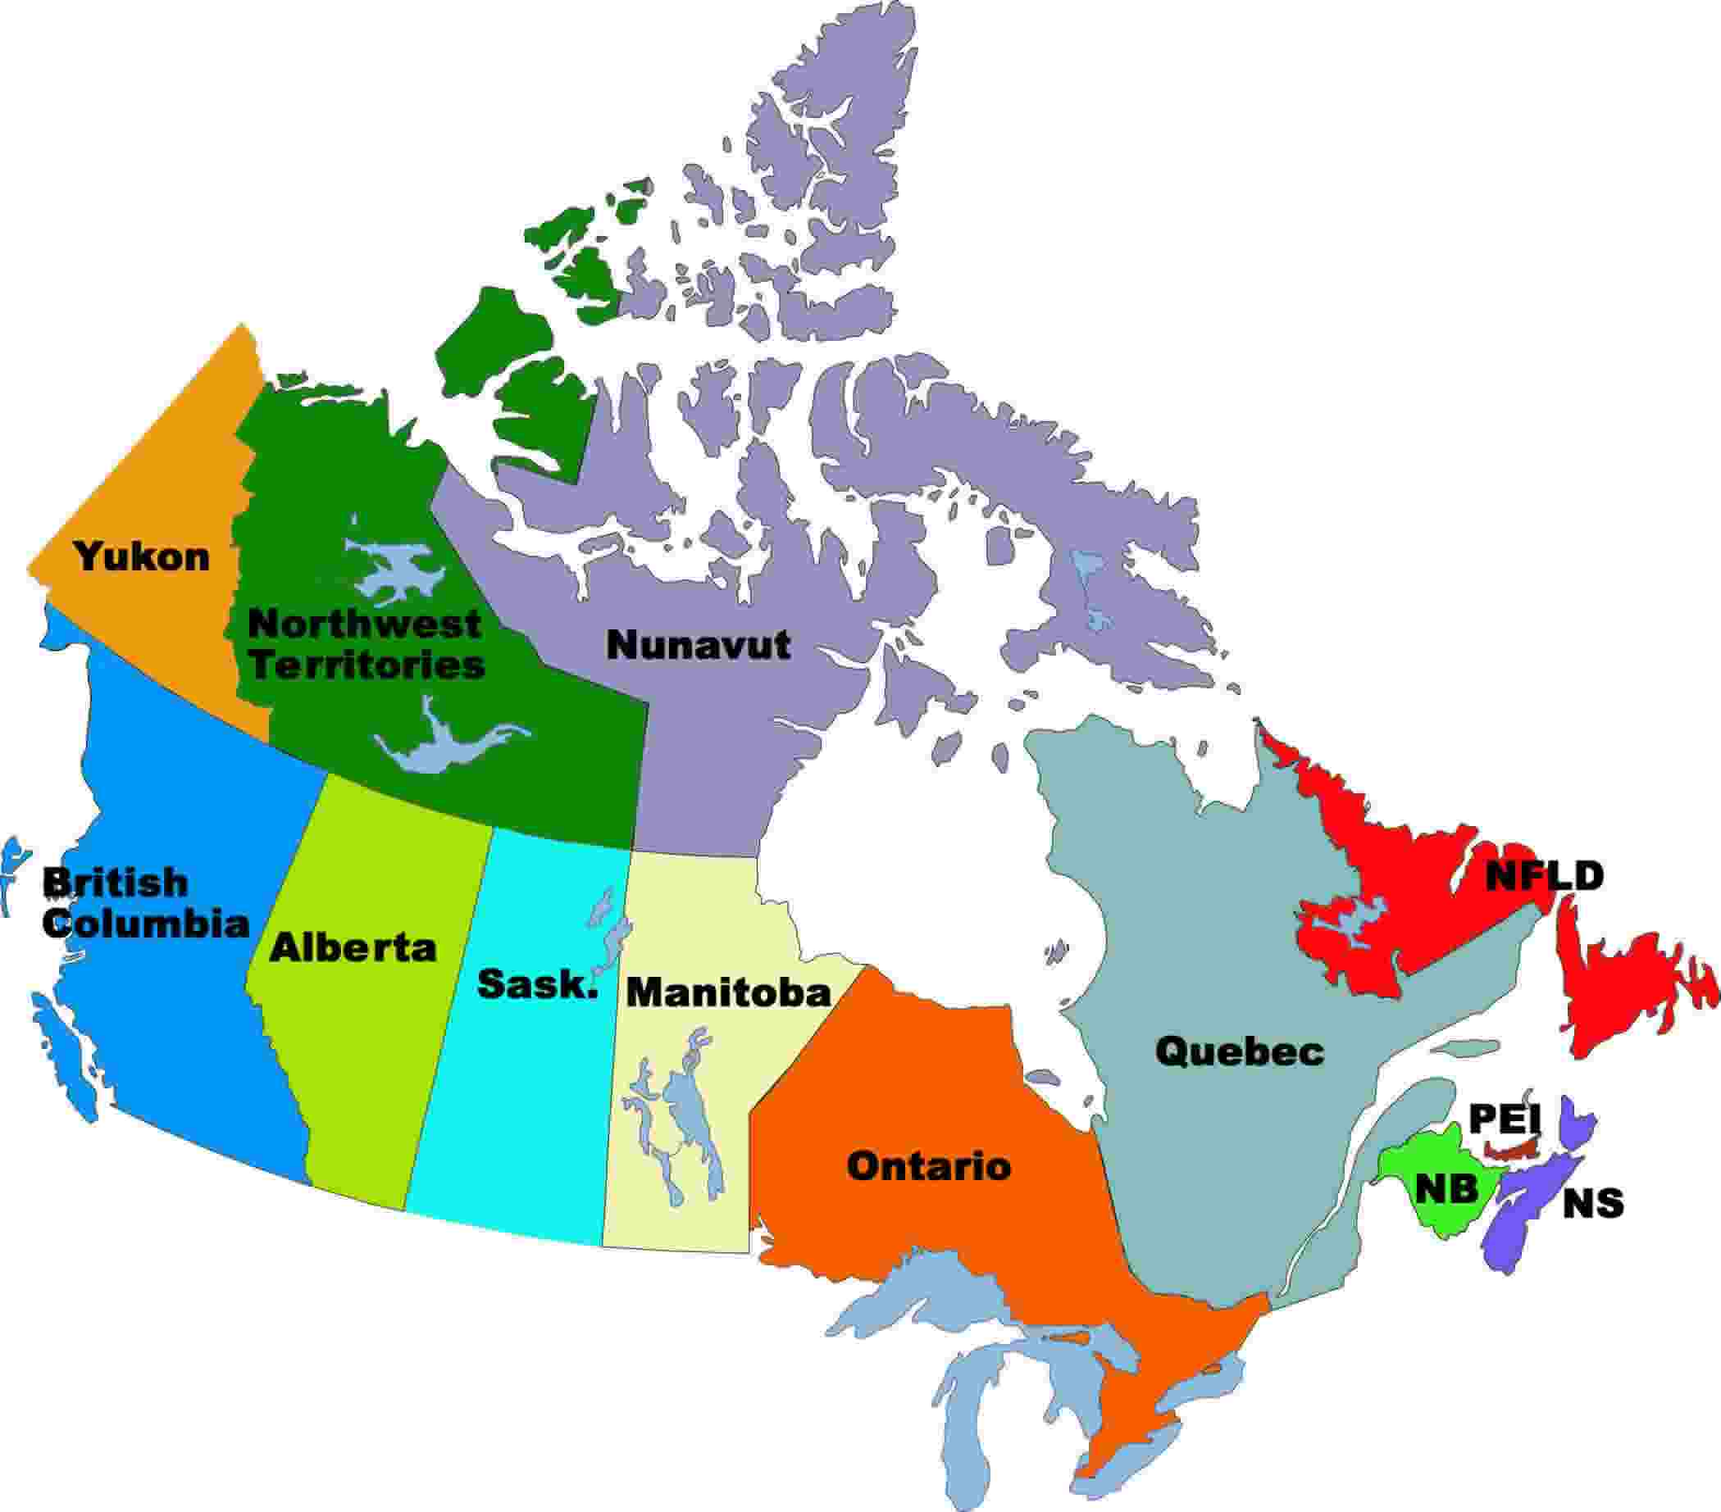

Slide 4
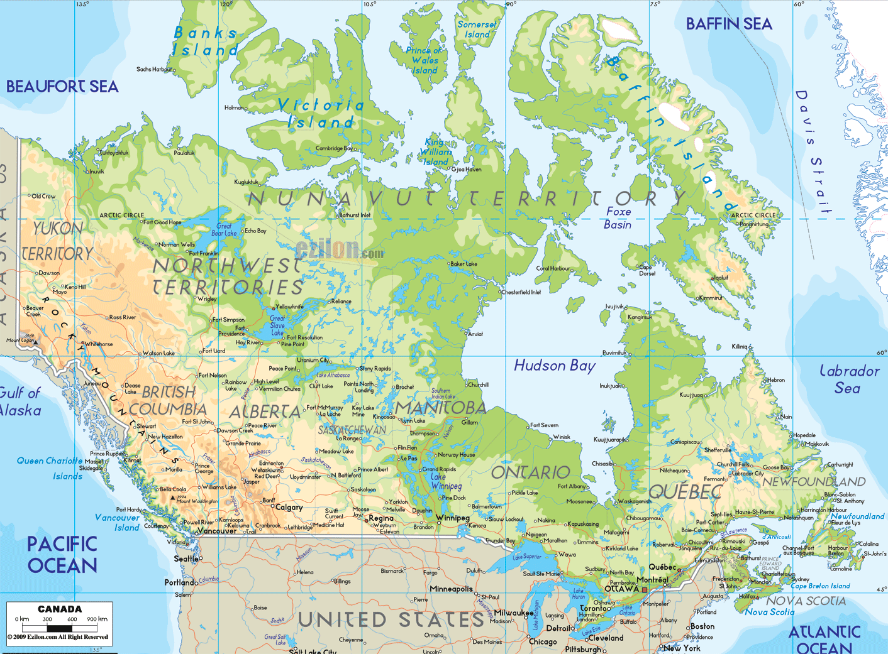

Slide 6
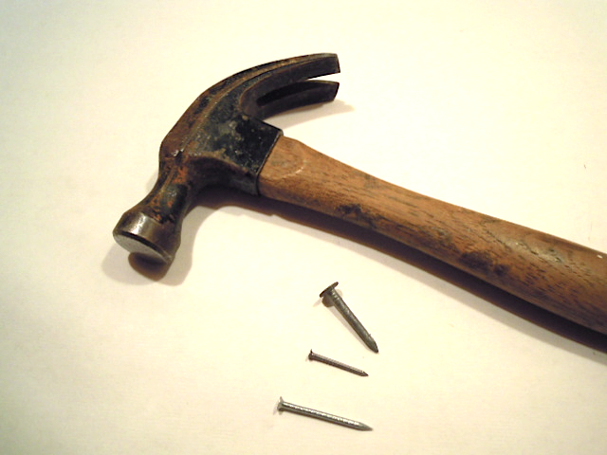

Slide 7
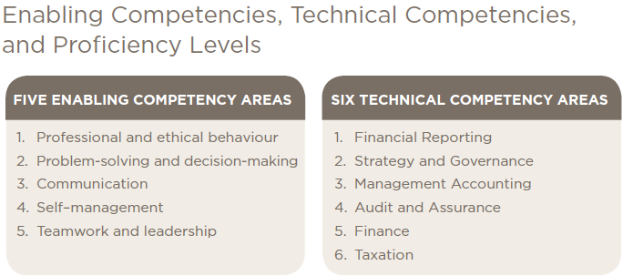

Slide 8
Partnerships and Accounting Faculty
Bodies
Brains
Support

Slide 9
AWG – Accounting Staffing Questions
How do we increase the numbers of PhD students in accounting (financial management)?
How do we increase the number and/or proportion of PhD students in accounting with a professional accounting designation and with relevant professional and business experience?
How do we increase the number and/or proportion of full time university accounting faculty members with a professional accounting designation and with relevant professional or business experience?

Slide 10
AWG – Collaboration Questions
Can we strengthen the accounting profession’s involvement in University programs to the benefit of students, the profession, faculty members, and universities, while respecting the autonomy of universities?
Can we create stronger relationships between academics and practitioners with respect to creating research that is perceived to be relevant by both groups and disseminating it?

Slide 11
Faculty Staffing – AACSB Influence
Participating faculty members “actively and deeply engage in the activities of the school in matters beyond teaching responsibilities.”
Four categories:
Scholarly Academics (SA) hold doctorates and focus on “academic” research
Instructional Practitioners (IP) have substantial practical experience both in duration and in level of responsibility.
There are less common off-diagonal categories of Scholarly Practitioners (SP) and Practice Academics (PA)
Faculty Resources are calculated as a weighted summation that allows for members whose commitment to the University is less than 100%
Notes:
Academic research is peer reviewed research published in academic journals recognized as quality outlets with respect to tenure and promotion decisions at business schools and/or accounting departments within universities.
SP and PA are off-diagonal relatively infrequent categories. Practitioners who transition to become involved in research in a significant way OR academics who shift to have predominantly a relationship with external practice
A full time faculty member is considered to be 100% employed fulfilling the school’s mission. For example, if there are ten faculty members with five full-time and five working 50%, then total faculty resources totals 7.5. At least 90% of faculty resources must be one of SA, PA, IP, or SP. At least 40% of faculty resources must be SA. At least 60% of faculty resources must be SA, PA, or SP. Alternatively, no more than 40% of faculty resources can be IP. Research schools are expected to have higher proportions of SA.

Slide 12
AWG – AACSB Constraints
There are important but manageable constraints to the shortage of accounting faculty
Participating faculty must teach at least 75% of curriculum and at least 60% of any program
All four of SA, IP, SP, PA are welcome, but
40% or more must be SA, higher at research schools
No more than 40% can be IP
Barriers to IPs include university regulations, union contracts, and AACSB professional recognition criteria
Clearly we need more PhDs, but the shortage can also be addressed through practicing IPs.
many Schools are well below 40% practicing IPs
Notes:
Implication of 1 is that you can’t hire many people just to teach.
Implication of 2a is you need some PhDs who are active researchers.
Implication of 2b is that you can use professionals
Implication of 1 and 2b is that these people must be more fully involved in the School, if we are to meet AACSB requirements honestly

Slide 13
AWG – Attracting More PhDs: Marketing
Collaboration among CFBSD, CPA-Canada, CAAA
Develop a concerted marketing campaign to attract young professionals to PhD programs
Develop documents listing advantages of an academic life
Develop common web site with appropriate materials with links from established professional and academic sites
Orientation conferences close in time to achieving professional accreditation
Older professionals are more likely to be attracted to IP positions
Opportunities to test the teaching experience
Notes:
Advantages are many
Relevance of academic career,
opportunity to educate future financial leaders,
research to extend knowledge and influence professional, business, and public policy
explore interesting questions of one’s own choosing
many advantages to a university lifestyle
ability to manage time
more than adequate compensation
Given opportunity costs, we expect it ismore fruitful to attempt to attract younger professionals to become PhDs

Slide 14
AWG – Attracting More PhDs: Funding
CPA Canada and provincial institutes along with the AWG to:
Try and generate more funds
Try and develop a system whereby funded PhDs can work anywhere in Canada without financial penalty
Funding will remain provincial, but provincial institutes will arrange for inter-provincial financial fairness without encumbering the student

Slide 15
AWG – A Place for Instructional Practitioners?
Financial education develops professional competencies
technical skills
plus thinking strategically, problem-solving, and interpersonal skills.
Professional experience enhances curriculum development and the classroom experience.
Professional education requires a blend of both academic and professional abilities among the instructors.
This blend can be found in a PhD with professional experience
The blend can also be found through a proportion of practicing IP instructors in the Faculty complement
Notes:
Note that PhDs are increasingly from overseas and lack institutional experience and knowledge

Slide 16
AWG – IP Pragmatic Issues
AACSB and some universities require IPs to have a Masters
We think that a Bachelor’s degree combined with Canadian professional designation is equivalent
Some universities and/or union contracts will not allow IPs
A judicious blend of IPs are an asset
They bring professional knowledge and experience
They are dedicated and enthusiastic
With IPs included in a team of instructors, students have a more comprehensive learning experience
IPs are a partial, but constructive, response to the shortage of faculty members

Slide 17
AWG – Possibilities for CFBSD
Support a permanent AWG:
to develop the marketing of PhD programs
To develop other initiatives for collaboration with the profession
Support in principle the use of practicing IPs
Affirm the value of IPs
Ultimately includes:
overcoming institutional and contractual obstacles
creating career paths
appropriate compensation and respect for IPs
Develop through AWG the case for the Canadian CPA to be considered equivalent to Masters.
Make the case to AACSB, EQUIS, and any relevant Government groups

